Slide 1
Application of evolutionary computation to the advanced image processing
Farid Ghareh Mohammadi
Ph.D Student in Computer Science Department at
University of Georgia

Slide 2
Outlines:
Problem statement
Summary
Curse of Dimensionality
Stegnalaysis Examples IFAB and RISAB
Steganography VS Steganalysis
Preliminaries of Evolutionary algorithms

Slide 3
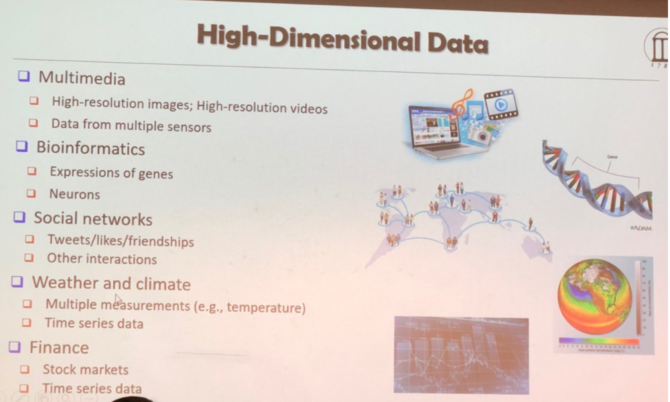
Emerging problems:

Slide 4
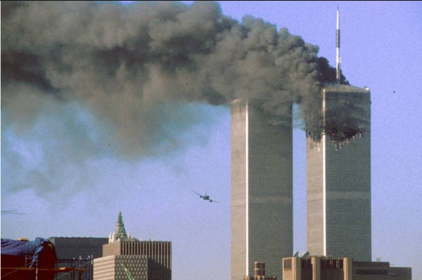
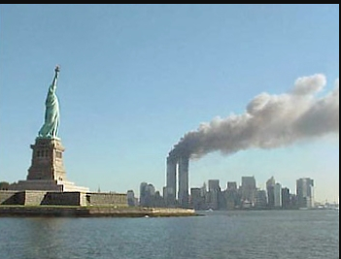
Steganalysis Started getting important …
September 11 2001

Slide 5
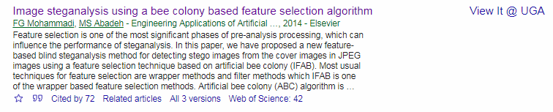
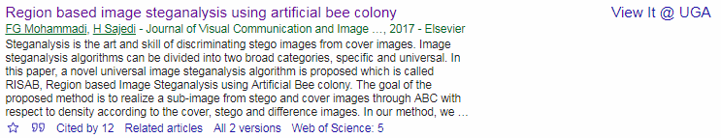
Work to be discussed
IFAB
RISAB

Slide 6
Introduction to Image Proceesing
The world of Computer Technology
Hardware
Image processing
Evolutionary computation
Machine Learning
Medical Imaging
Steganography & Steganalysis
Data Mining
Artificial Intelligence
ABC
Software
Computer science
Notes:
Detecting unknown rules
How ever, they have some techniques in common
We try to predict future and model the performance of every thing.. We want to help hamunbeing.
By getting to know required information can give you good advice, 80 % 20%

Slide 7
Very Quick Shot
Art of embedding messages
Art of detecting the hidden Messages
Steganography
Steganalysis

Slide 8
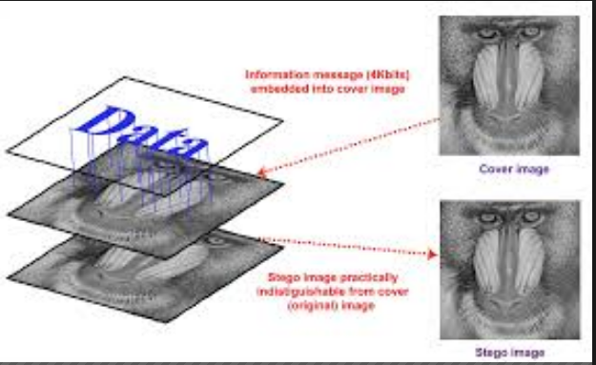
Image Processing Steganography VS Steganalysis

Slide 9
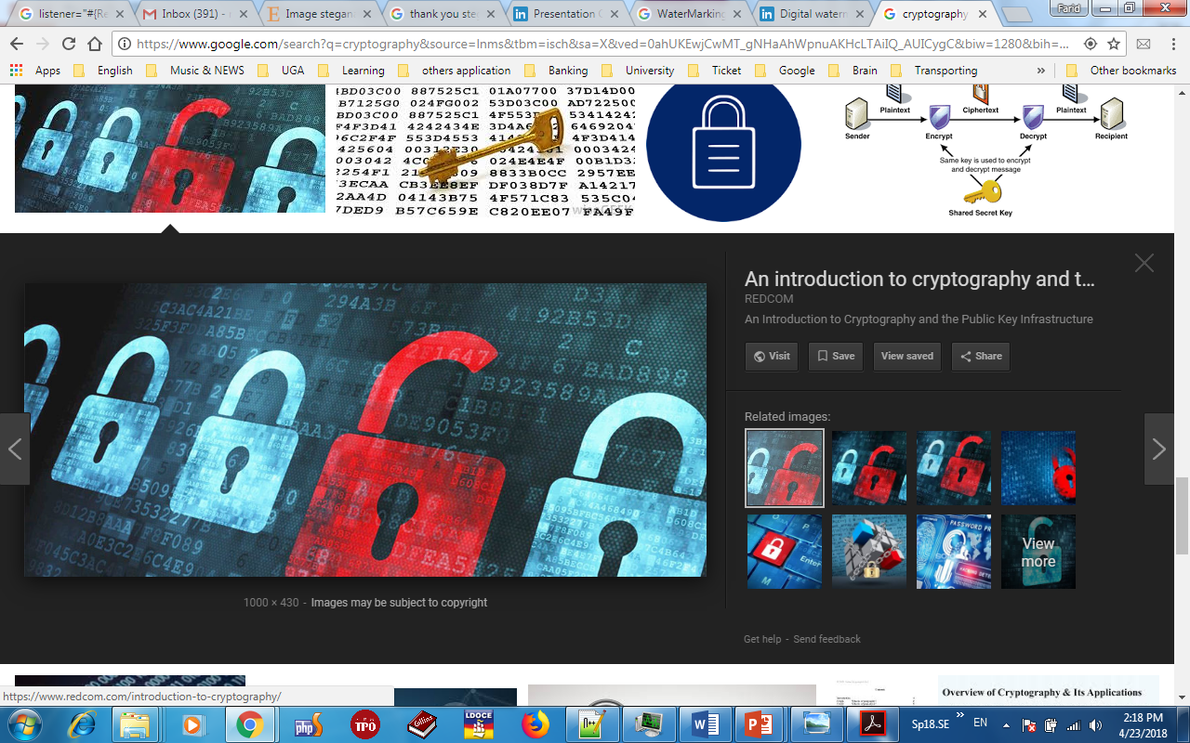
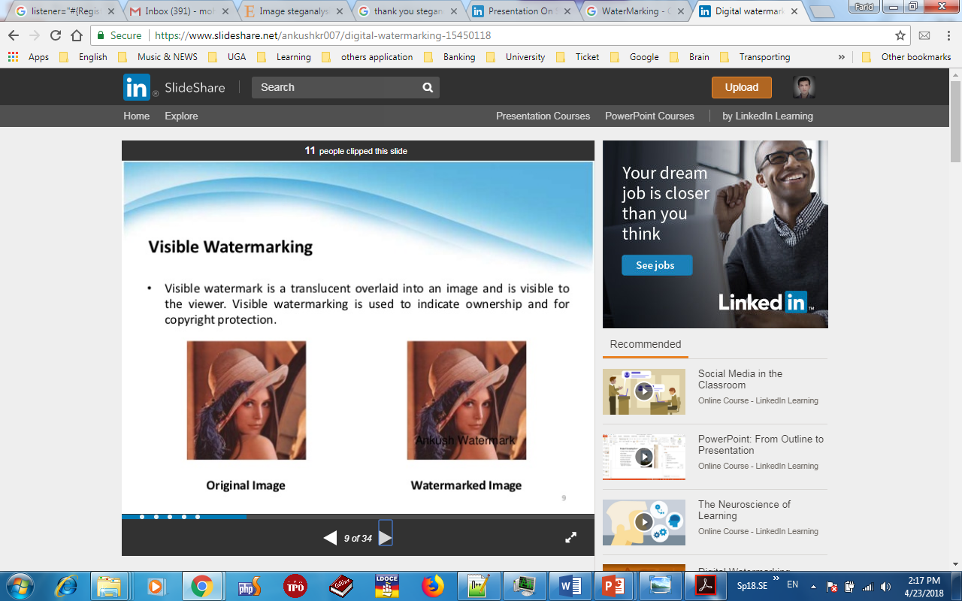
Steganography In comparison with others
WaterMarking
Cryptography
Steganography
Security level

Slide 10


Stego VS Cover

Slide 11
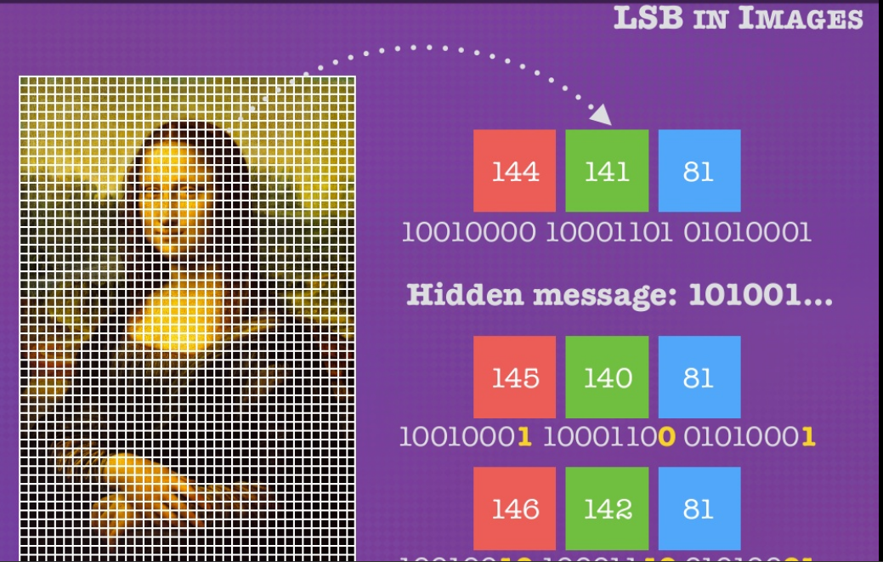
Image Processing Steganography VS Steganalysis
One Channel Image
Triple Channel Image
RGB
HSV
Binary
Gray
(0-255)

Slide 12
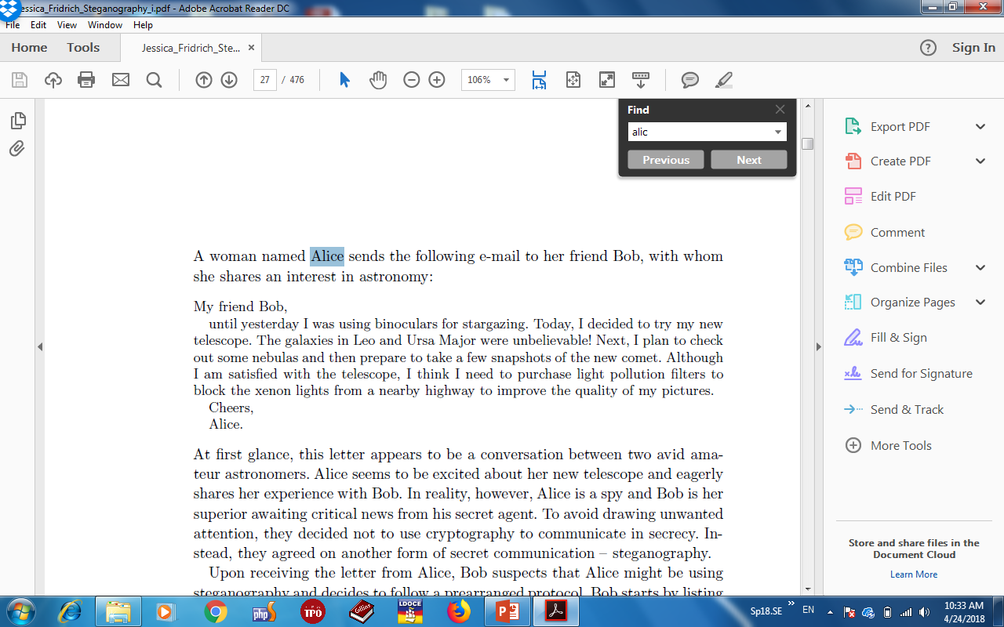
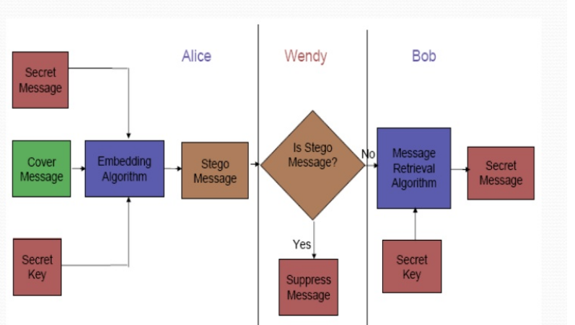
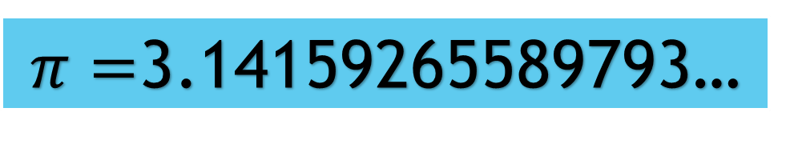
General Overview Steganography VS Steganalysis
MfBuyIwubfsTIdttmntTgiLaUMwuNIptcosnatpttafs
otcAIaswttItIntplpftbtxlfanhtitqompCA
$π=$3.14159265589793…
Clear?
Buubdlupnpsspx
Attack Tomorrow

Slide 13
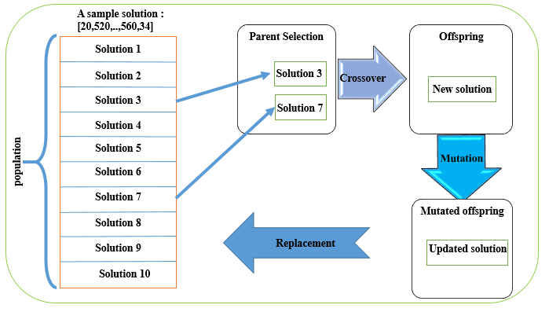
Preliminaries of Evolutionary algorithms
Ghareh Mohammadi et al 2019

Slide 14
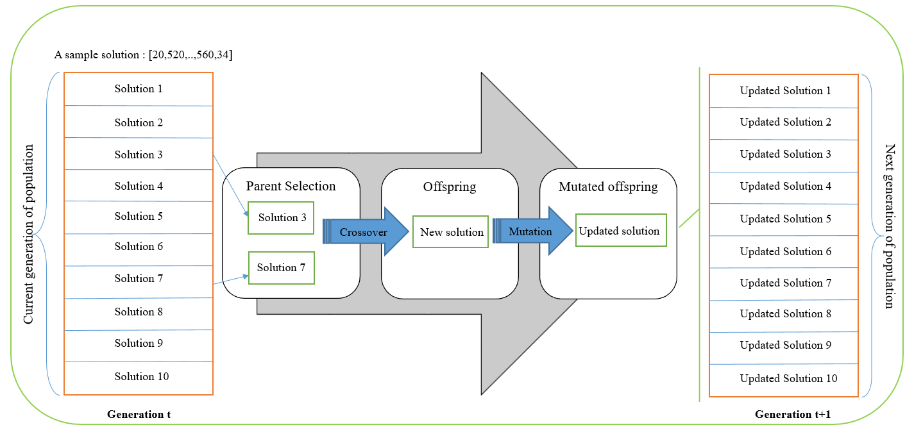
Preliminaries of Evolutionary algorithms
Ghareh Mohammadi et al 2019

Slide 15
Preliminaries of Evolutionary algorithms
Cross over: regular combination through all generation
Mutation:
Random updating solution, after crossover

Slide 16
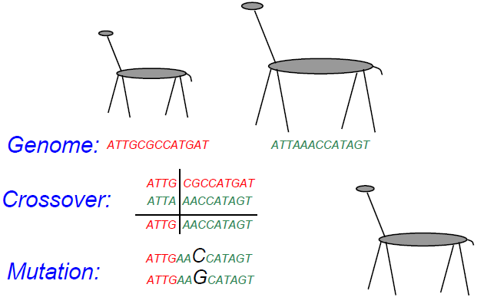
Reproduction
Derived from evolutionary computation slides (Prof Rasheed )

Slide 17
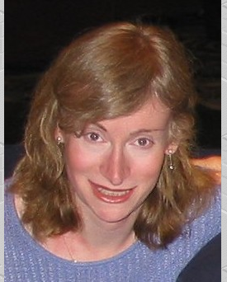
Why Evolutionary algorithms?
AKA: Curse of Dimensionality (CoD) : too much information!
 | Dimension
SRMQ1 | 12,753 | SRMQ1.m | Spatial | [10]
SPAM | 686 | spam686.m | Spatial | [6]
CC-PEV | 548 | ccpev548.m | JPEG | [5,3]
J+SRM | 35,263 | see Notes | Both | [2]
PSRM3 | 12870 | PSRM.m | Spatial | [11]
(PSRM8) | -34320 | PSRM.zip
 |  | PSRM.tar
PSRM | 12870 | PSRM.m | Spatial | [12]
 |  | PSRM.zip
 |  | PSRM.tar
CSR | 1183 | CSR.m | Spatial | [13]
DCTR | 8000 | DCTR.m | JPEG | [14]
 |  | DCTR.zip
 |  | DCTR.tar
maxSRM | 34,671 (12,753) | maxSRMq2d2.zip | Spatial | [15]
SCRMQ1, CRMQ1 | 12753 + 5404 | SCRMQ1.m | Spatial, color | [16]
PHARM | 12600 | PHARM.m | JPEG | [17]
 |  | PHARM.zip
 |  | PHARM.tar
CFA-aware CRM | 5514, 4146, 10323 | SRMQ1CFA.m | Spatial, color | [18]
GFR | 17000 | GFR.m | JPEG | [19]
sigma-features | 1980 | sigma-spamPSRM.m | spatial | [20]

Slide 18
Feature Extraction Optimization
Feature Extraction
Feature Selection
Wrapper based
Filter based
Dimension Reduction
LDA
PCA

Slide 19
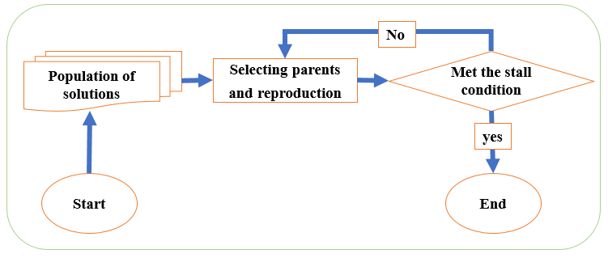
General procedure of Evolutionary algorithm
Ghareh Mohammadi et al 2019

Slide 20
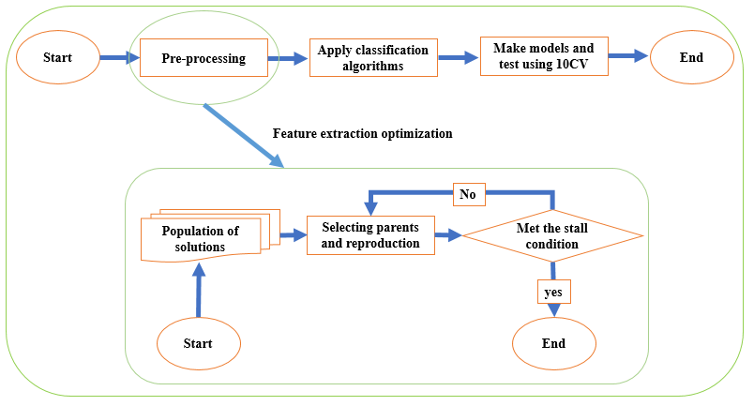
General procedure of Evolutionary algorithm
Ghareh Mohammadi et al 2019

Slide 21
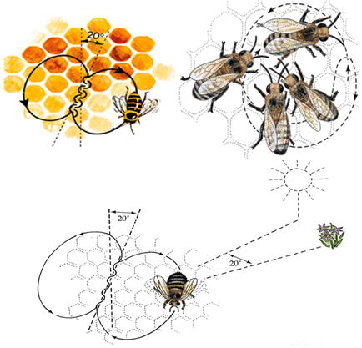
Presented by Karaboga in 2005
Artificial Bee Colony
Continues problems
Exploring
Exploiting

Slide 22

Task: gather nectars using Employed bee #=10
y
*
*
*
*
*
*
*
*
*
*
x

Slide 23
5 best places have been chosen by onlooker
y
▪
▪
▫
▫
▫
*
*
*
*
*
x

Slide 24
Sending onlooker bees to be at the best places
Hive
* *
* *
y
* *
*
▪
*
*
*
▪
*
*
*
▫
*
*
*
▫
*
▫
*
*
*
x

Slide 25
Exploiting the best point in the environment
y
*
▪
*
*
*
▪
*
*
*
▫
*
*
*
▫
*
▫
*
*
*
x

Slide 26
Choosing scout bee one at a time to explore
y
*
o
*
*
o
*
o
o
*
o
x

Slide 27
Goal is finding the global maximum
y
*
x

Slide 28
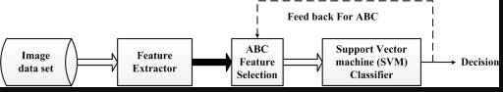
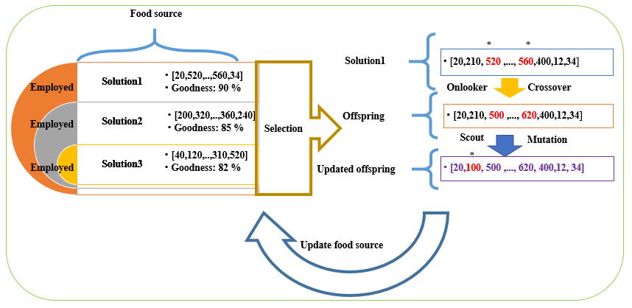
IFAB
Ghareh mohammadi et al 2014, 2019

Slide 29
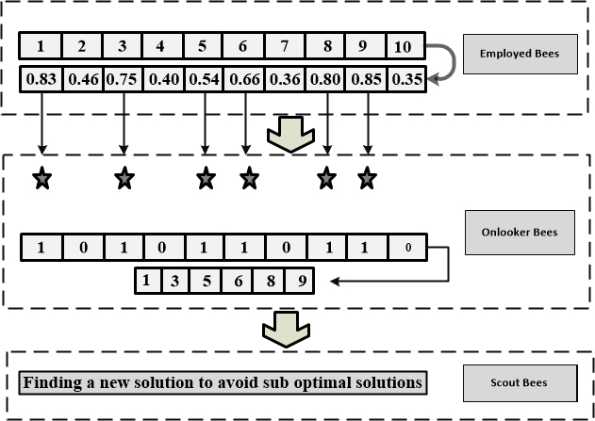
IFAB
Ghareh mohammadi et al 2014

Slide 30
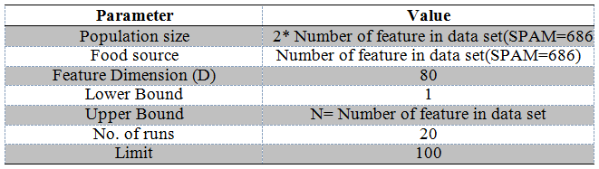
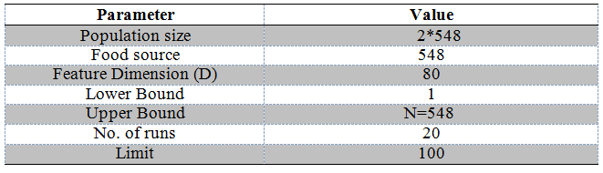
IFAB-parameters
Ghareh mohammadi et al 2014

Slide 31
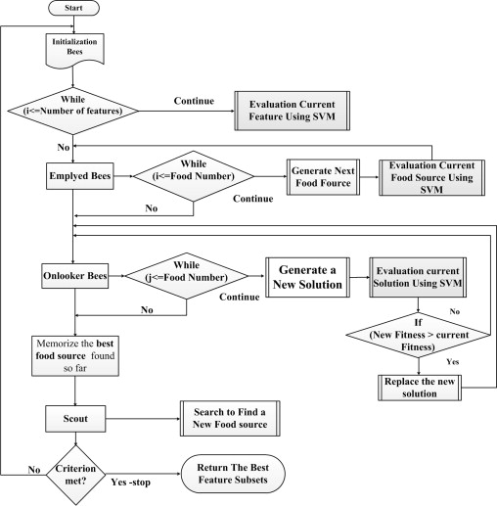
IFAB
Ghareh Mohammadi et al 2014

Slide 32
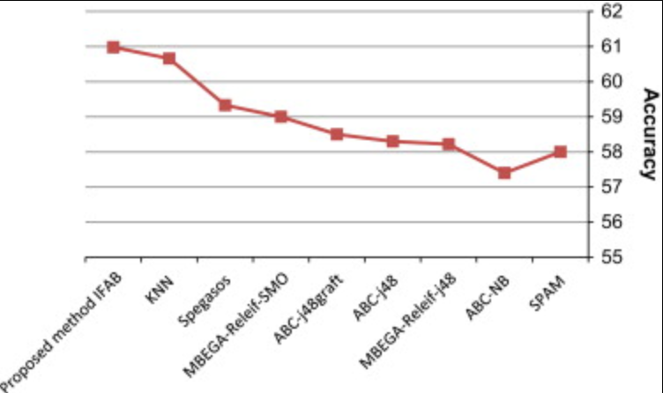
Result-SPAM
Ghareh Mohammadi et al 2014

Slide 33
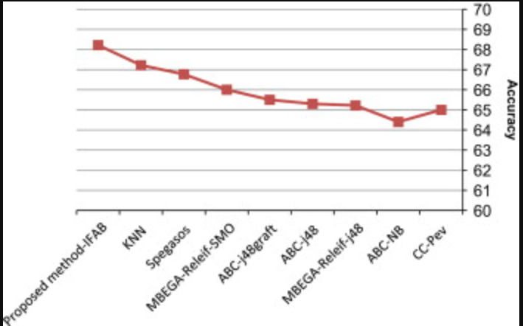
Result-CCPEV
Ghareh Mohammadi et al 2014

Slide 34
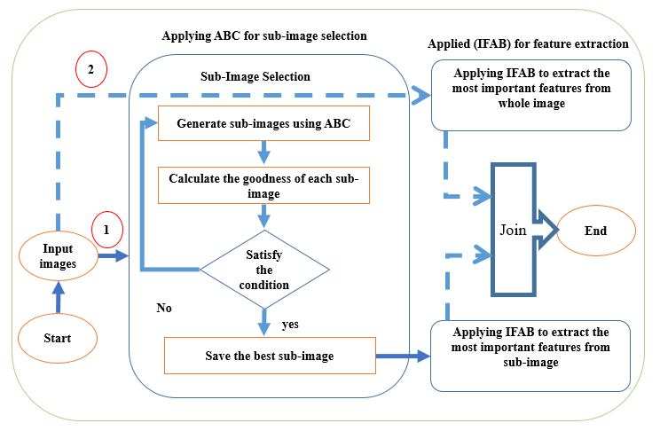
RISAB
Ghareh Mohammadi et al 2017

Slide 35
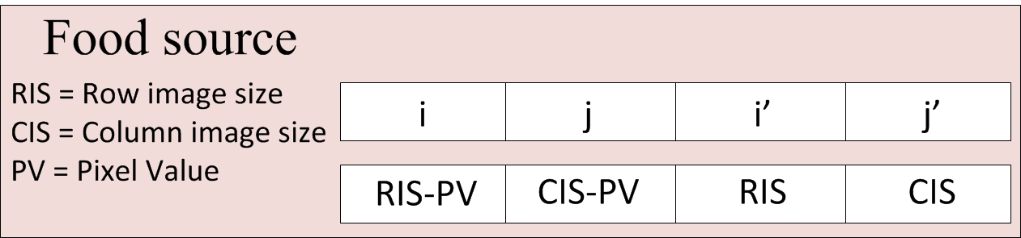
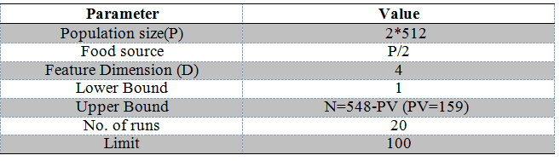
Risab -Parameters
Ghareh Mohammadi et al 2017

Slide 36
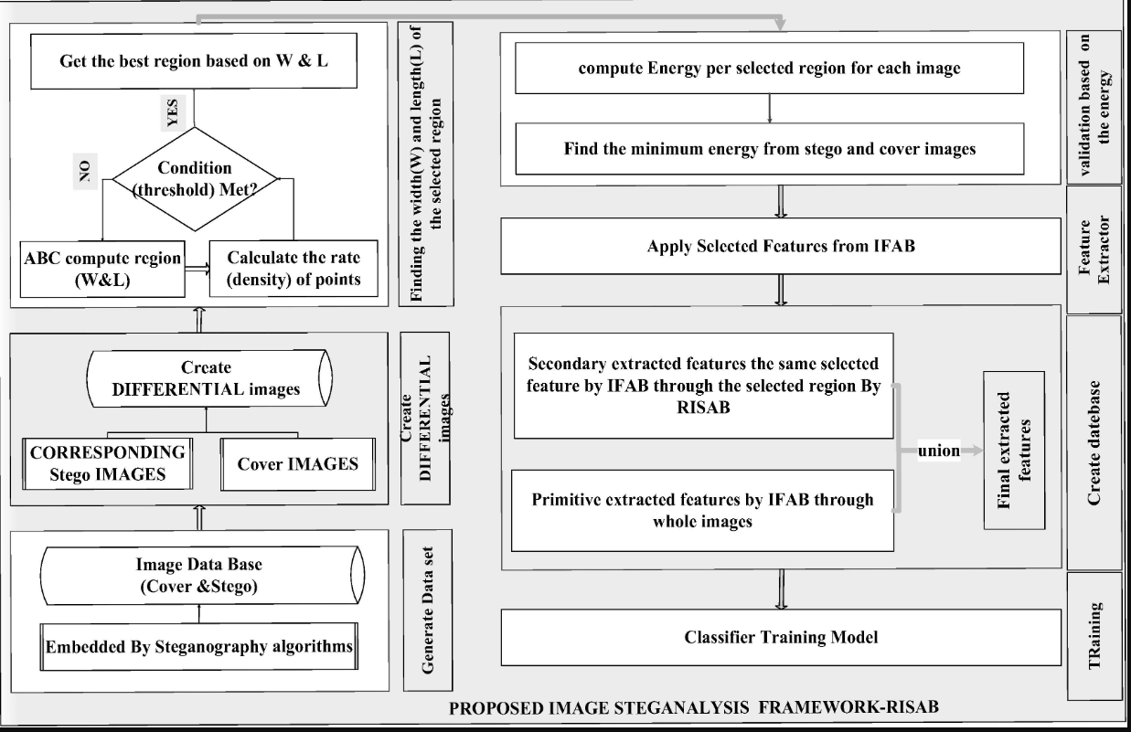
RISAB
Training
Ghareh Mohammadi et al 2017

Slide 37
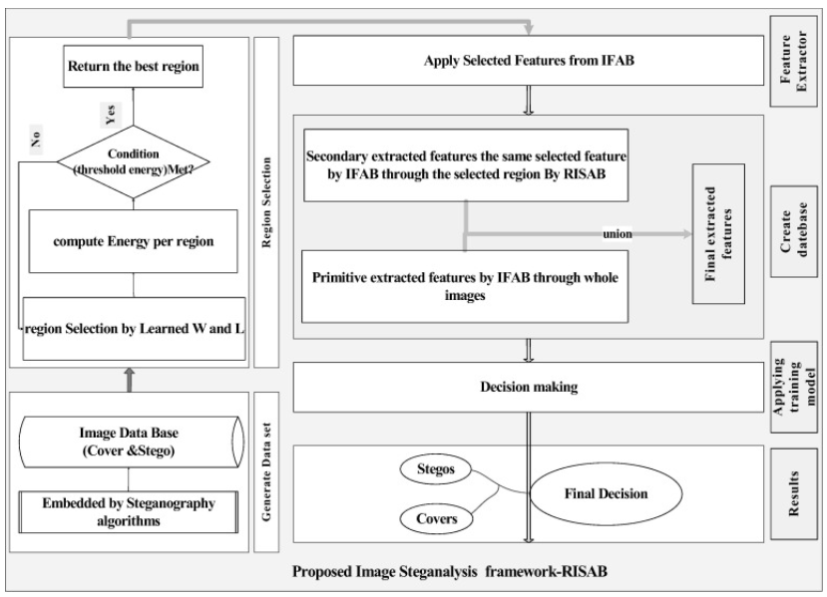
RISAB
Testing
Ghareh Mohammadi et al 2017

Slide 38
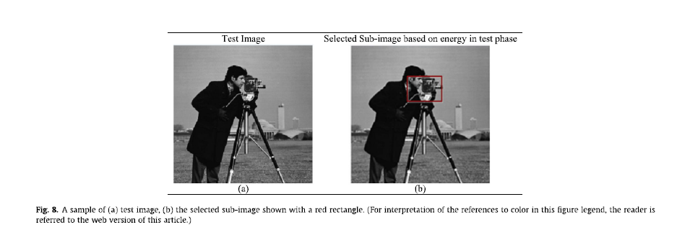
RISAB-example
Ghareh Mohammadi et al 2017

Slide 39
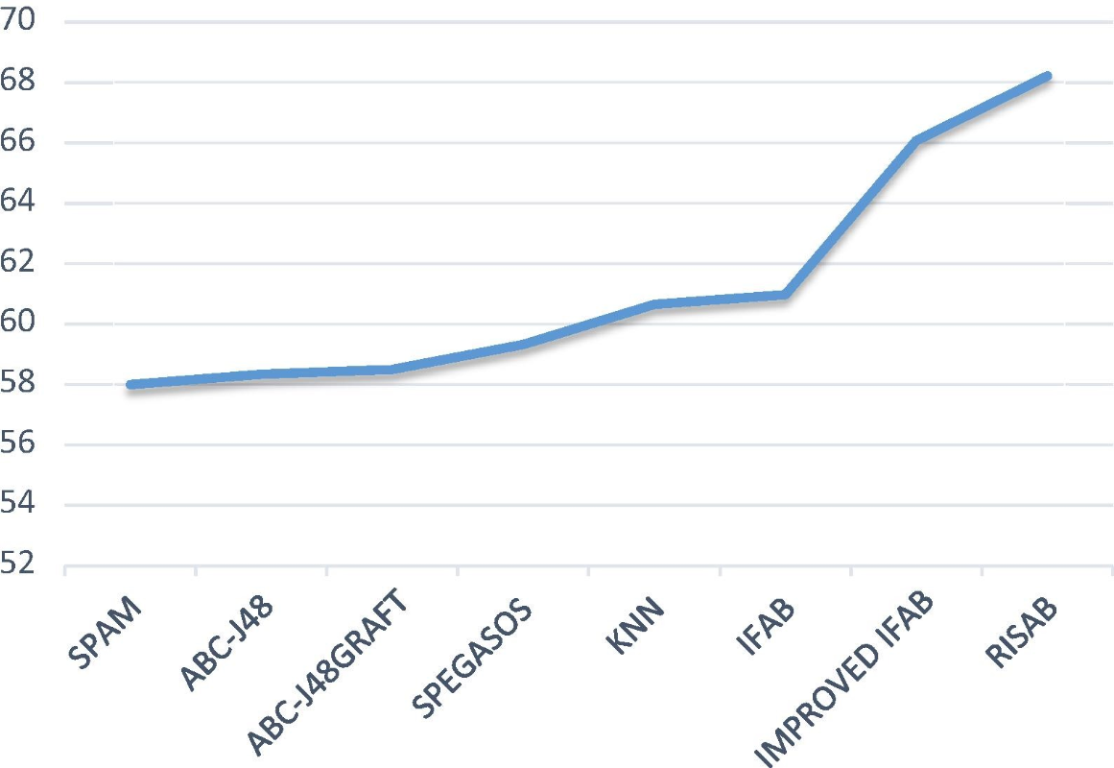
Result-SPAM
Ghareh Mohammadi et al 2017

Slide 40
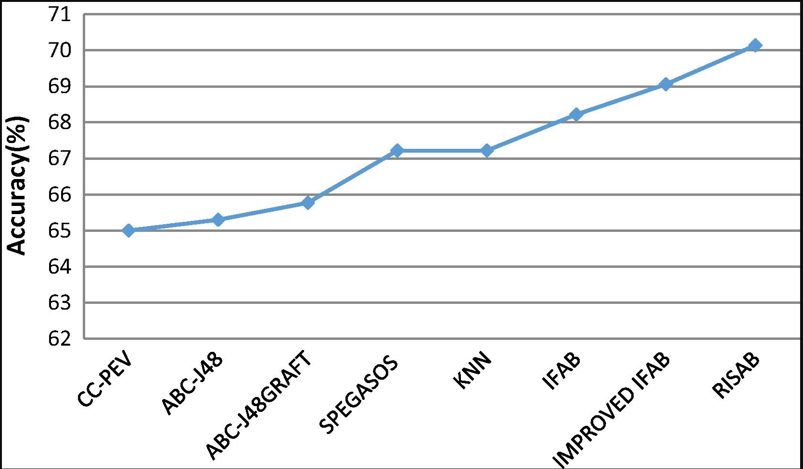
Result-CC-PEV
Ghareh Mohammadi et al 2017

Slide 41
Summary
Possible image problems
Steganalysis VS Steganagrophy
Evolutionary algorithms and Feature Extraction
Artificial Bee colony
ABC application

Slide 42
References:
Thank you
http://ice.dlut.edu.cn/LiMing/research.html
https://doi.org/10.1016/j.jvcir.2016.12.003
https://www.redcom.com/introduction-to-cryptography/
https://www.slideshare.net/ankushkr007/digital-watermarking-15450118
Steganography in Digital Media,Principles, Algorithms, and Applications By Dr Jessica Fridrich
http://www.ws.binghamton.edu/fridrich/
https://www.sciencedirect.com/science/article/pii/S0952197613001905#f0010
https://www.sciencedirect.com/science/article/pii/S1047320316302516#f0070
https://arxiv.org/pdf/1908.08006.pdf
https://arxiv.org/pdf/1908.08563.pdf

